Slide 1
Accelerating Cervical Cancer Elimination
12th December 2018
Julie Torode, UICC
“We unite the cancer community to reduce the global cancer burden, to promote greater equity, and to integrate cancer control into the world health and development agenda.”

Slide 2
Summary
01 | Supporting the WHO EB discussion, Jan. 2019
02 | WHO Initiative towards cervical cancer elimination
03 | Planning for World Cancer Day 2019
 | Working together as civil society
 | Teaming up with advocates outside cancer networks
04 | Updating and expanding the CCA maps Identifying and outreach to national rapporteurs

Slide 3
Plans and how you can help
WHO Executive Board

Slide 4
WHO Executive Board - 24 Jan - 1st Feb 2019
Agenda Item 6.5: Accelerating cervical cancer elimination
Background document: http://apps.who.int/gb/ebwha/pdf_files/EB144/B144_28-en.pdf
Three main strategic components and accelerators:
Vaccination against human papillomavirus
HPV DNA screening & treatment for pre-cancers
Diagnosis, treatment & palliative care of invasive cancer
Supportive context:
Health systems support
Political support
Global coordination
Financing & return on investment
Monitoring & evaluation
Research & innovation

Slide 5
Country champions
Led by Australia, as they are just joining the EB for a 3-year term
Co-Sponsors: Zambia, Thailand, Brazil, Austria and Morocco
First mission information sessions
July at UICC offices
Formal information session by WHO November
43 countries attended !
Co-sponsors will convene a session early January
How can you get involved?
Share the news of the agenda item; background paper
Encourage your government to join the January session
Share feedback – positive and negative
Would they like to co-sponsor? Notify UICC or Australian mission

Slide 6
The plan
Request a EB decision in January
Documents request to DG to develop a global strategy and action plan
Return to EB/WHA in 2020
Allows initiation of consultations via the regional offices of WHO from February
Allows global online consultation
How can you get involved?
Explain the decision – consultation and 2020 launch and seek support
Encourage expression of support for the elimination ambition during the EB
Feed any questions or concerns back to UICC, we can work with WHO to provide a response
Make sure you get invited to the regional consultation
Engage your government ahead of the consultations
Work with us to develop a CSO position ahead of the consultations

Slide 7
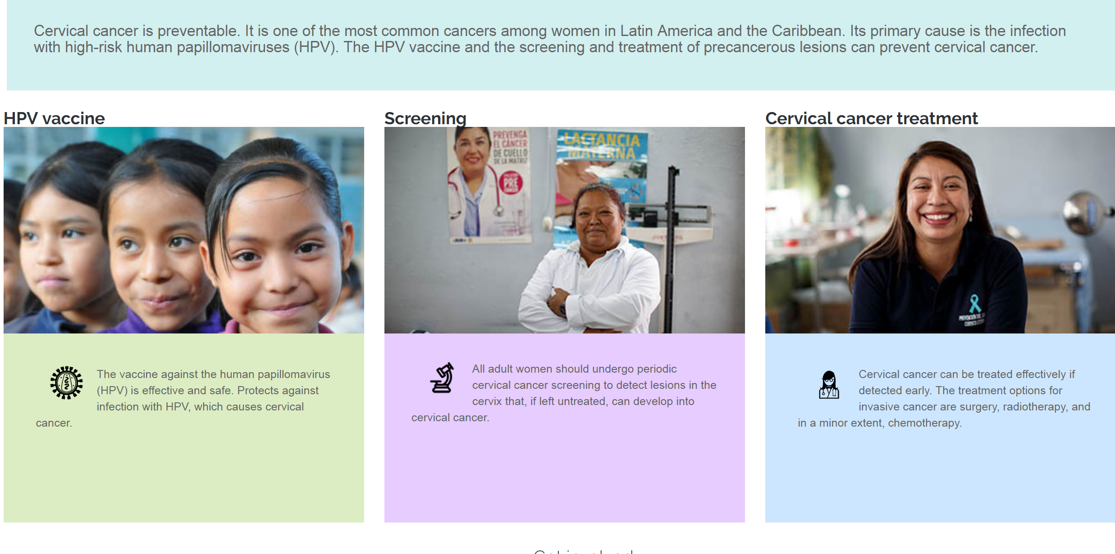
Building support and regional commitment
Are there events in your region or country that could feature the elimination ambition?
Ask for a plenary
Consider an activity to socialise and garner support for elimination of cervical cancer
Consider working with others beyond the cancer field, coalitions are powerful
Are there reports or publications that could feature elimination?
Example PAHO In English: https://www.paho.org/hq/index.php?option=com_content&view=article&id=14299:fin-cancer-cervical&Itemid=72265&lang=en
In Spanish: https://www.paho.org/hq/index.php?option=com_content&view=article&id=14299:fin-cancer-cervical&Itemid=72265&lang=es

Slide 8
Key milestones in 2019
Women Deliver 2019 – Vancouver, June 03-06 Are you attending? Share your plans
WHO-led side event, press activities planned
National engagment planned
We are keen to coordinate with all to have a strong «share of voice» for cervical cancer elimination
UN General Assembly 2019 – New York City, September
Focus on universal health coverage
Walk the Talk event in Central Park

Slide 9
Treatment
for All

Slide 10
National activation in 2019: New Country Champions and Mentors to join the initiative
In 2018, UICC launched ‘Treatment for All’ – an ambitious new advocacy campaign that aims to address the global equity gap in access to cancer services. Through its national activation initiative, UICC provided technical support and guidance to three Country Champions representing civil society organisations from Indonesia, Mexico, and Uganda.
At the 2018 World Cancer Leaders’ Summit in Kuala Lumpur, we announced a call for Country Champions and Mentors to express their interest in joining Treatment for All. We received over 100 expressions of interest for Country Champions and over 30 for Mentors, from across every region. Following a competitive selection process, 2019 Country Champions and Mentors will be announced on World Cancer Day 2019. UICC looks forward to working with its members to consolidate progress toward achieving Treatment for All.
Watch this film to learn more about the initiative.

