Slide 1
New, in February 2019
https://www.who.int/ncds/management/palliative-care/cancer-pain-guidelines/en/

Slide 2
Pain, often severe pain, is experienced by about half of women undergoing anti-cancer treatment and by two thirds or more of women who have advanced, metastatic, or terminal cervical cancer
The goal of relieving pain to a level that enables an acceptable quality of life can be achieved effectively in 80-90% of patients
The first update of WHO guidelines focused on cancer pain management since 1996
Describes the pharmacologic and radiotherapeutic management of cancer pain in adults and adolescents
Provides evidence-based guidance to initiate and manage cancer pain for physicians, nurses, pharmacists and caregivers
Assist policy-makers, programme managers and public health personnel to create and facilitate appropriately balanced policies on opioids and prescribing regulations for effective and safe cancer pain management.
“The clinical guidelines and recommendations in this document are organized into three focal areas, says Dr Cherian Varghese, NCD Coordinator at WHO, analgesia of cancer pain, the choice of analgesic when initiating pain relief and the choice of opioid for maintenance of pain relief; adjuvant medicines for cancer pain such as the use of steroids, antidepressants and anticonvulsants and management of pain related to bone metastases, this includes use of bisphosphonates and radiotherapy”

Slide 3
A recent patient support network post A women living with cervical cancer, location unknown
Hi girls, can you advise me on what pain killers to take?
I am waiting for more scan results, but I am suffering massively with back pain, swollen nodes in the neck and now hip and rib cage pain.
I've been given a drug which isn't helping at all. My doctor also gave me opioids but they do not work, its like I haven't taken a thing. My doctor cant understand it either.
I'm really struggling with the outbreaks of pains in my bones and down my arms. I feel like screaming ….

Slide 4
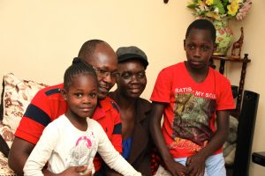
An abstract from Evelyne's story, Kenya
http://www.hospicecarekenya.com/stories/evelynes-story/
Evelyne and her family live in a small flat in Umoja, Nairobi.
Evelyne was diagnosed with cervical cancer at the age of just 37.
She has had two courses of chemotherapy but the cancer has spread. Swellings on her breast bone cause her pain in her chest and shoulders. An ultrasound confirmed a painful a leg swelling was a blood clot.
She is feeling very weak and sleepy. “I don’t feel well. With getting the news that the chemo didn’t work, the cancer coming back, I just feel so down”, she told us tearfully, unable to speak in more than a whisper.
Mercy, the nurse from Nairobi Hospice, has been visiting Evelyne regularly to help with her medication and to provide support. Evelyne is taking medication to control both her pain and symptoms, and to counteract the side effects. This complex combination of medicines is closely monitored and balanced by Mercy.
Evelyne has also attended day care sessions at Nairobi Hospice. “When I go to the hospice it feels like home. It’s good to go and discuss with other cancer patients, it really helps. The nurses provide a good service”.
Hospice nurse Mercy explains Evelyne’s medication to her husband

Slide 5
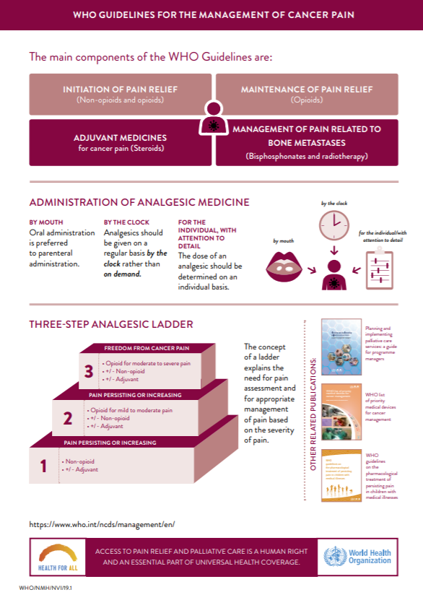
Useful factsheet and infographics

